Slide 1
DriverPass System Analysis
Ifeoluwa Adewoyin
Notes:
[No speaker notes required for this slide.]

Slide 2

System Requirements
Functional Requirement Online reservation system for driving lessons
Practice tests and online classes for students
Nonfunctional Requirements
24/7 system availability with 99.9% uptime
Secure handling of user data and payment information
Notes:
I am presenting key functional and nonfunctional requirements for the DriverPass system. Let me explain each of these and how they meet DriverPass's needs:
Functional Requirements:
Online reservation system for driving lessons: This directly addresses Liam's requirement for customers to be able to make reservations online. It allows students to book driving lessons at their convenience, which is a core feature of the DriverPass business model.
Practice tests and online classes for students: This fulfills Liam's vision of providing comprehensive training, including online classes and practice tests. It's particularly important for the "Package Three" option he described, which includes access to online content and material.
Nonfunctional Requirements:
24/7 system availability with 99.9% uptime: While not explicitly stated by Liam, this requirement is crucial for an online business. It ensures that students can access the system at any time, which is essential for a service that aims to provide flexibility and convenience.
Secure handling of user data and payment information: This addresses the need to securely manage sensitive information. Liam mentioned collecting credit card information from customers, so ensuring the security of this data is paramount for both legal compliance and customer trust.
These requirements form the foundation of the DriverPass system, addressing the core functionalities needed to run the business (lesson reservations and online learning) while also ensuring the system is reliable and secure. This aligns perfectly with Liam's vision of providing a comprehensive, accessible, and trustworthy driver training service.

Slide 3
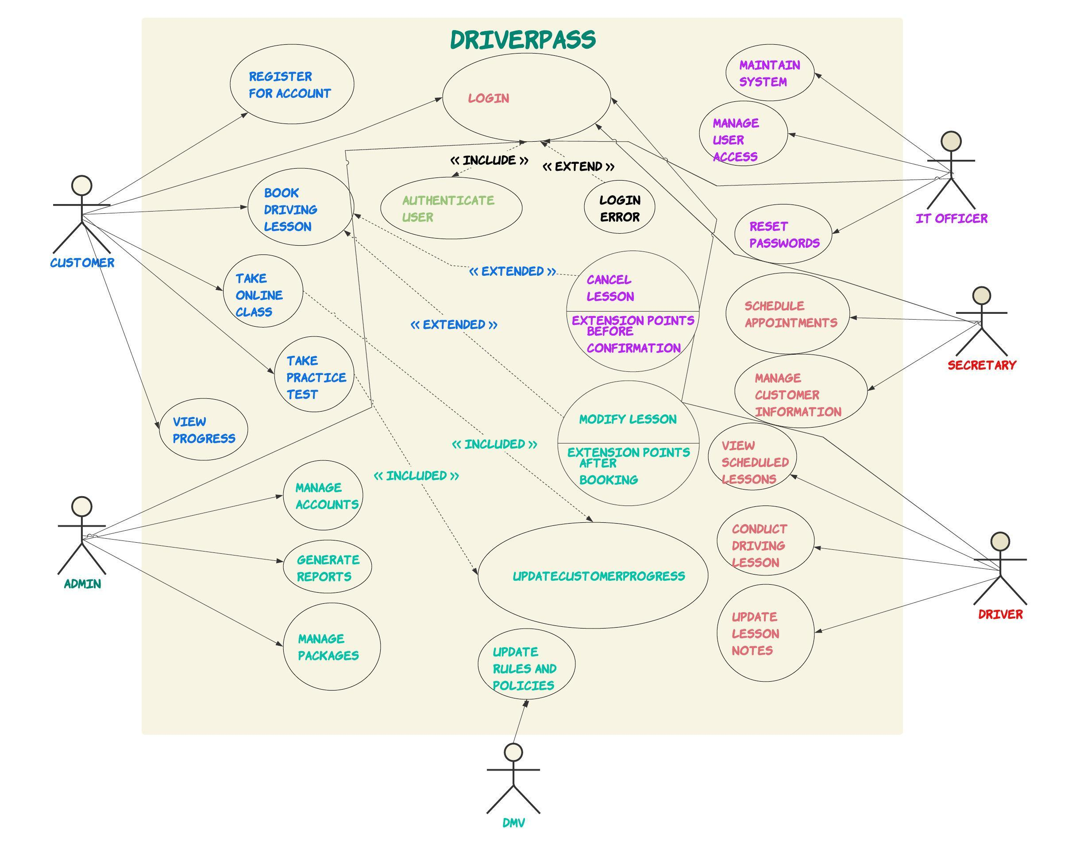
Use Case Diagram
Notes:
This diagram provides an overview of how different people will interact with the DriverPass system. Let me walk you through it:
First, we have the students, who are the primary users of the system. They can do several things:
Make, cancel, or change their reservations for driving lessons
Take online classes to learn about driving rules and best practices
Complete practice tests to prepare for their actual DMV exam
If they forget their password, they can reset it themselves
Next, we have the secretary. They can help students by:
Making reservations for them
Cancelling reservations if needed
Changing reservation details
The IT officer plays a crucial role in maintaining the system. They can:
Manage user accounts, which includes creating new accounts and helping users who are locked out
Reset passwords for users who are having trouble doing it themselves
The owner/Admin, that's you Liam, has special access to:
Generate reports about how the business is doing
Update information from the DMV when there are changes to rules or procedures
Lastly, we've included the DMV as part of the diagram. While they don't directly use our system, they provide important updates that we need to incorporate into our training materials.
We designed this system with DriverPass's needs in mind. For example:
Students can manage their own reservations online, just as you requested
We've included the online classes and practice tests, which are key parts of your business model
The secretary can help students who prefer to book over the phone
You, as the owner, can keep track of the business through reports
We've made sure to include a way to keep the system updated with the latest DMV information
This design ensures that everyone can do their job efficiently, from students learning to drive, to your staff managing the day-to-day operations, to you overseeing the business as a whole. It's all about making the driver training process as smooth as possible for everyone involved.

Slide 4
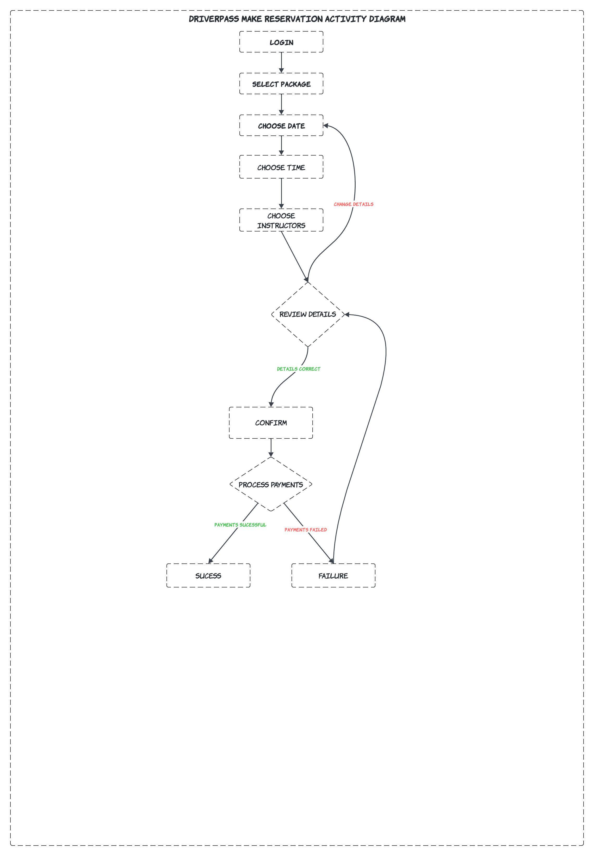
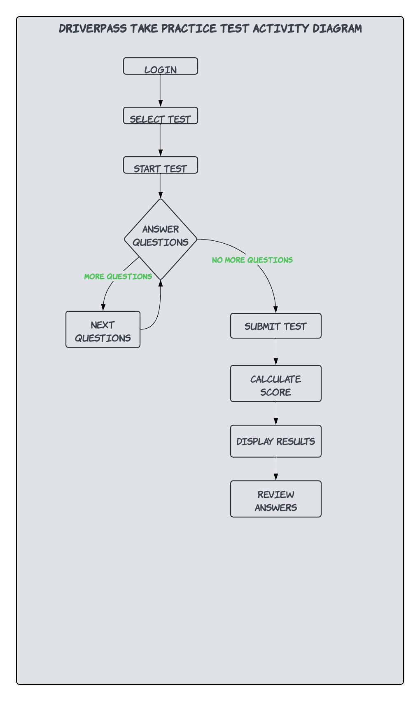
Activity Diagram
Notes:
We're looking at two important processes in the DriverPass system. These diagrams show step-by-step how certain tasks are completed. Let me walk you through each one.
The first diagram breaks down the process of making a reservation for a driving lesson. Here's how it works:
The student starts by logging into their account.
They choose which package they want - remember, we have three different options.
Next, they pick a date for their lesson.
Then, they select a time that works for them.
They can also choose a specific instructor if they have a preference.
The system shows them all the details of their reservation to review.
If everything looks good, they confirm the reservation.
Finally, they make the payment to secure their spot.
If at any point they need to change something, they can go back and adjust the details before confirming.
The second diagram shows how a student takes a practice test. This is how it goes:
Again, the student starts by logging in.
They choose which practice test they want to take.
The test begins, and they answer each question one by one.
When they finish, they submit their answers.
The system calculates their score right away.
The student can then see their results.
They also have the option to review their answers and see which ones they got right or wrong.
We designed these processes with DriverPass's needs in mind. For the reservation system, we made sure students can easily book their lessons online, just as you requested. They can choose their package, time, and even instructor, giving them the flexibility you wanted to offer.
For the practice tests, we've created a straightforward process that allows students to test their knowledge and immediately see their results. This fits perfectly with your goal of preparing students for their actual DMV tests.
Both of these processes are designed to be user-friendly and efficient, making it easy for students to use your services and for you to manage your business. They cover key aspects of what DriverPass offers - practical driving lessons and theoretical test preparation.

Slide 5

Security: How Our Design Addresses Security Concerns
Secure login system to protect user accounts
Encryption of sensitive data, especially payment information
Regular security audits to identify and address vulnerabilities
Different access levels for students, instructors, and administrators
Notes:
Security is a top priority in our design for the DriverPass system. We've implemented several measures to ensure that your data and your customers' data remain safe and protected. Let me walk you through the key security features we've built into the system:
Secure login system: We've implemented a robust login process to protect user accounts. This means that each user - whether they're a student, instructor, or administrator - will have their own unique username and password. We also encourage the use of strong passwords to make it harder for unauthorized people to guess them.
Encryption of sensitive data: We know that you'll be handling sensitive information, especially when it comes to payments. That's why we've made sure to encrypt all sensitive data. Think of encryption like a secret code - even if someone unauthorized somehow got access to the data, they wouldn't be able to understand or use it without the key.
Regular security audits: We've built into our plan regular check-ups of the system's security. This is like having a security expert regularly inspect your home for any weak points. We'll be looking for any potential vulnerabilities and addressing them promptly to keep the system as secure as possible.
Different access levels: Not everyone needs access to every part of the system. That's why we've set up different levels of access. Students will only be able to see and do what's necessary for their learning. Instructors will have additional access to manage their schedules and student information. Administrators, like yourself, will have the highest level of access to oversee the entire system. This way, we minimize the risk of accidental or unauthorized changes to important information.
These security measures are designed to protect DriverPass, your employees, and your customers. We want to ensure that everyone can use the system with confidence, knowing their personal and financial information is safe.
Remember, in today's digital world, demonstrating strong security measures can be a real selling point for your business. It shows your customers that you take their privacy and security seriously, which can help build trust and credibility for DriverPass.

Slide 6

System Limitations Understanding Our System's Boundaries
Dependent on internet connectivity for all online features
Limited offline functionality
Requires regular updates to stay current with DMV regulations
May require additional features for future scaling
Notes:
As I wrap up our presentation, it's important to discuss some limitations of the DriverPass system. Every system has its boundaries, and being aware of these helps us use the system most effectively and plan for future improvements. Let's go through the main limitations:
Dependence on internet connectivity: The DriverPass system is designed to be accessed online, which offers great flexibility but also means that a stable internet connection is necessary to use most features. If the internet goes down, access to the online parts of the system will be temporarily unavailable.
Limited offline functionality: Because the system is primarily online, there's not much that can be done offline. This might affect users in areas with unreliable internet connections. For instance, while students can download some materials to study offline, they won't be able to take practice tests or book appointments without an internet connection.
Need for regular updates: Driving laws and DMV regulations can change over time. Our system will need regular updates to stay current with these changes. This means we'll need to have a process in place to regularly review and update the content in our online classes and practice tests.
Potential need for additional features as the business grows: Right now, the system is designed to meet your current needs. But as DriverPass grows and potentially offers new services, we might need to add new features. The good news is that we've designed the system to be flexible, but it's something to keep in mind for future planning.
Understanding these limitations is important because it helps set realistic expectations. It also guides us in planning for the future. For example, we might want to consider developing some offline capabilities in future versions of the system, or set up a regular schedule for content updates.
Remember, these limitations don't diminish the value of the DriverPass system. They're simply aspects we need to be aware of to use the system most effectively and to plan for future improvements. Every system has its limitations, and being upfront about them allows us to manage them proactively.
We're excited about the potential of DriverPass and are confident that this system will greatly enhance your ability to provide top-notch driver training services. As we move forward, we'll continue to look for ways to improve and expand the system's capabilities.

